Slide 1
A Perfect Storm: the impact of the Covid-19 pandemic on domestic abuse survivors and the services supporting them
Sarah Davidge – Research and Evaluation Manager
Women’s Aid
www.womensaid.org.uk
www.womensaid.org.uk/evidence-hub/

Slide 2
What is domestic abuse
Domestic abuse takes place within an intimate or family relationship using a pattern of controlling, coercive, threatening, degrading or violent behaviour making it very hard for women to end the relationship
Coercive control is an act or a pattern of acts of assault, threats, humiliation and intimidation or other abuse that is used to harm, punish, or frighten their victim.
It can involve any or all of physical or sexual violence; emotional and/or psychological abuse; financial or economic abuse; harassment and stalking; and online or digital abuse
Domestic abuse can happen to anyone, regardless of age, social background, gender, religion, sexuality or ethnicity”. It is very common and in most cases is experienced by women and perpetrated by men.

Slide 3
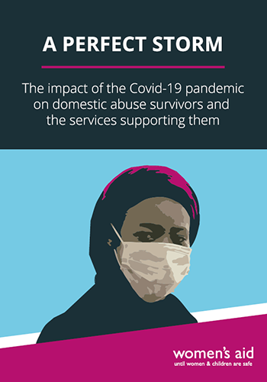
A Perfect Storm: Women’s Aid research on the impact of Covid-19
In what ways have abusers used the Covid-19 pandemic as a tool for domestic abuse?
In what ways have the choices and needs of women experiencing domestic abuse been impacted by Covid-19?
In what ways has the Covid-19 pandemic affected the specialist domestic abuse support sector?
https://www.womensaid.org.uk/evidence-hub/

Slide 4
How have abusers used the pandemic as a tool for abuse
67% said that their abuser had used the pandemic as a tool for abuse in one or more way/s.
38% said their abuser refused to take precautions against the virus.
46% of survivors currently experiencing domestic abuse told us that their abuser has made them feel bad for being scared or worried about Covid-19.
30% said their abuser had blamed them for the economic impact of Covid-19 on their household.
(Women’s Aid April and June Survivor Surveys)
“I’m shielding and [my abuser] uses not getting me food or medication to control me”.
“…my ex-partner has used his knowledge of my reduced support network to escalate his emotionally abusive & controlling behaviour - thinking that I have no one to turn to…”

Slide 5
Survivors are experiencing increased isolation and fear
“I’m lonely, feel isolated, like a sitting duck.”
“… when he had been abusive no-one would come and help due to the Covid-19...”
“Living with my ex felt like being imprisoned in my home, this lockdown has bought back feelings of fear, loneliness, isolation.”
Since lockdown:
52% of survivors responding felt more afraid
58% felt they had no-one to turn to
32% felt friends and family couldn’t help them leave
53% of survivors who had experienced abuse in the past, said that the pandemic had triggered memories of abuse and affected their mental health.
(Women’s Aid June Survivor Survey)

Slide 6
Survivors are seeing their means of escape reduced
Covid-19 can make it more difficult for women to leave an abuser, particularly if they share a home:
In April over three quarters of survivors (78.3%) told us that Covid-19 has made it harder for them to leave their abuser.
In June, 48% of those living with the abuser still felt they couldn’t leave or get away because of the pandemic
10% of survivors experiencing current abuse said they’d tried to leave and the abuser had used restrictions to stop them leaving
“I am working from home and my partner is a key worker but been home all the time I can’t get out to view flats and leave”
“Leaving hasn't been something I can consider because of the pandemic. Things are escalating and I'm sure it's going to continue getting worse.”

Slide 7
Child survivors also experienced worsening abuse during lockdown.
“I have two small children … They are experiencing more [abuse] as they are witnessing it more”
“My biggest concern is that my child may be given back to our abuser if I were to become seriously unwell with the virus or not survive.….”.
Of survivors with children:
53.1% told us that their children have witnessed more abuse towards them
37.5% said their abuser had shown an increase in abusive behaviour directed towards their children.
47% expressed their fear that the children would be left alone with the abuser if they became ill
(Women’s Aid April Survivor Survey)

Slide 8
Impact on local domestic abuse support services
Service providers have reported that their capacity to support survivors is impacted by Covid-19:
Impact on fundraising, including concerns around future funding
Impact on staff including challenges around caring roles and negative impact on mental health
Challenges preparing for remote working
Reduced availability of refuge spaces and move on accommodation during lockdown
Concerns around future demand
“We have found that more women referred to our community-based services have needed longer term and more in-depth support than before the pandemic. We think this is because they generally have complex needs and also there is a lack of availability of other agencies to support them. We need more trained staff in order to cope with demand in the future.”

Slide 9
Women’s Aid research into impact of Covid-19
“I wanted to leave the relationship. However since Covid-19 and the lockdown coming into effect it has made it harder to leave. I am a keyworker who is around COVID +ve patients, so I don’t feel like I could go home and stay with my parents…”
“It’s hell on earth living 24/7 now with my abuser & can’t get out to escape put distance between us when I feel tension rising”
“More time at home magnifies the issues, you can’t get away from it, I have to work harder to keep him happy.”
Find out more at: https://www.womensaid.org.uk/evidence-hub/
Contact us at research@womensaid.org.uk

